Slide 1
SRS – Hostel management system
Version: 1.0

Slide 2
01
02
Table of Contents
03
04
Mercury
Describe the topic here
Mars
Describe the topic here
Jupiter
Describe the topic here
Saturn
Describe the topic here

Slide 3
01
Introduction
Enter a subtitle here if you need it

Slide 5
HMS: Vision & Mission
Vision
Mission
Jupiter is a gas giant and the biggest planet of them all
Venus has a very beautiful name, but terribly hot

Slide 6
New Product Detailed Overview
Jupiter
01
It’s a gas giant and the biggest planet in the Solar System
Saturn
02
Saturn is composed mostly of hydrogen and helium
Mercury
03
It’s the closest to the Sun and the smallest of them all

Slide 7
External Source of Ideas
Mercury
Neptune
Mercury is the smallest planet and closest to the Sun
Neptune is the farthest planet from the Sun
Earth
Mars
Jupiter
Despite being red, Mars is a cold place full of iron oxide dust
Jupiter is a gas giant and the biggest planet of them all

Slide 8
External Source of Ideas
Mercury
Saturn
Jupiter
It’s the closest planet to the Sun
Saturn is a gas giant and has rings
It’s a gas giant and the biggest planet

Slide 9
You Have Two Columns Here
Mercury
Venus
Mercury is the closest planet to the Sun and also the smallest one in the Solar System
Venus has a beautiful name and is the second planet from the Sun. It’s terribly hot

Slide 10
You Have Three Columns Here
Mercury
Saturn
Jupiter
It’s the closest planet to the Sun
Saturn is a gas giant and has rings
It’s a gas giant and the biggest planet

Slide 11
Internal Source of Ideas
Jupiter
Venus
Jupiter is a gas giant and the biggest planet of them all
Venus has a very beautiful name, but terribly hot
Principal
Idea
Saturn
Moon
This planet is a gas giant made of hydrogen and helium
The Moon is a gravity rounded astronomical body orbiting Earth

Slide 12
Product Roadmap Process
Viable Product
Extended MVP
Launch
Minimal Viable Product
Concept
Test
Analysis
Check
Position
Selling
Build

Slide 13
Product Creation Process
Creativity
Concept
Design
Build the Product
Viable Product
Analysis
Test
Position
Check
Selling

Slide 14
Product Roadmap
Venus
Jupiter
Venus has a beautiful name
Jupiter is the biggest planet
A1
A2
B1
B2
B3
Mercury
Mars
Earth
Mercury is the smallest planet
Mars is a very cold place
Earth is the only planet with life

Slide 15
Product Roadmap
1
2
3
4
Mercury
Venus
Jupiter
Saturn
Mercury is the closest planet to the Sun
Venus is the second planet from the Sun
Jupiter is the biggest planet of them all
Saturn is the ringed one and a gas giant

Slide 16
Feasibility Review
Mercury
Jupiter
It’s the smallest planet of them all
It’s the biggest planet in the Solar System
Saturn
Mars
It’s a gas giant and has several rings
It’s a cold place. It’s full of iron oxide dust
Venus
Neptune
This planet has a very beautiful name
It’s the farthest planet from the Sun

Slide 17
Feasibility Review
02
01
03
Venus
Mercury
Saturn
This planet has a very beautiful name
It’s the smallest planet of them all
It’s a gas giant and has several rings

Slide 18
New Product Analysis
Mercury
01
Mercury is a small planet
02
Jupiter
Jupiter is the biggest planet
Mars
03
Mars is a cold place
04
Saturn
It’s a gas giant and has rings

Slide 19
New Product Analysis
Venus
Venus is the second planet from Sun
Mars
Mars is a cold place full of iron oxide
100%
75%
85%
80%
60%
60%
Saturn
Saturn is a gas giant and is hot
2020
2021

Slide 20
Detailed Analysis
Strengths
02
Weaknesses
Mercury is the smallest planet in the Solar System
Jupiter is a gas giant and the biggest planet of the mall
01
SWFB
03
Benefits
Features
Venus has a beautiful name and is the second planet
Despite being red, Mars is actually a cold place
04

Slide 21
Porter’s Five Forces Analysis
Threat of New Entrants
Bargaining Power of Buyers
Neptune is the farthest planet from the Sun
Mercury is the closest planet to the Sun
Competitors
Earth is the third planet from Sun
Bargaining Power of Suppliers
Substitute Products
This planet has a very beautiful name
Despite being red, Mars is actually a cold place

Slide 22
Product Life Cycle Stages
Introduction
Growth
Maturity
Decline
Product Development
Testing
Implementation
Enhancement
R&D
Margining
Maintenance
Technical Support

Slide 23
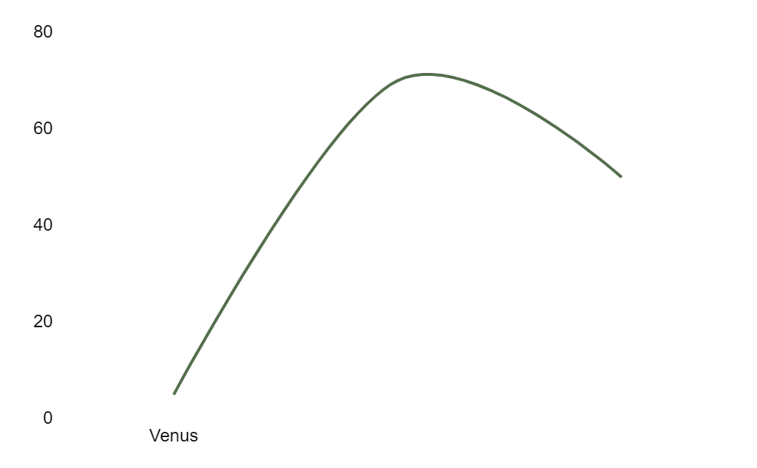
Product Life Cycle Stages
Introduction
Introduction
Growth
Maturity
Decline
Venus has a beautiful name
Growth
Pluto is now a dwarf planet
Sale
Maturity
Earth is the only planet with life
Jupiter
Time
Jupiter is the biggest planet

Slide 24
The Slide Title Goes Here!
Do you know what helps you make your point clear? Lists like this one:
They’re simple
You can organize your ideas clearly
You’ll never forget to buy milk!
And the most important thing: the audience won’t miss the point of your presentation

Slide 25
Maybe You Need Two Lists?
List 1
List 2
Write here what you need
Write here what you need
Write here what you need
Write here what you need
Write here what you need
Write here what you need
Write here what you need
Write here what you need
Write here what you need
Write here what you need
Write here what you need
Write here what you need

Slide 26
Introduction Stage
Venus
Pluto
Earth
Jupiter
Mars
Venus is the Roman goddess of love
Pluto is now considered a dwarf planet
Earth is the only planet with life
Jupiter is the biggest planet of them all
Despite being red, Mars is a cold place

Slide 27
Introduction Stage
Jupiter
It’s the biggest planet in the Solar System
Venus
Venus is the second planet from the Sun
Mars
Despite being red, Mars is a cold place

Slide 28
Growth Stage
Mercury
Mars
Neptune
Saturn
Mercury is the closest planet to the Sun
Despite being red, Mars is a cold place
Neptune is the farthest planet from the Sun
Saturn is a gas giant and has several rings

Slide 29
Growth Stage
Mercury
Mars
Mercury is the closest planet to the Sun
Despite being red, Mars is a cold place

Slide 30
BCG Matrix
Venus
Saturn
Venus is the second planet from the Sun
It’s a gas giant and has several rings
High
Market Growth Rate
Jupiter
Neptune
It’s the biggest planet in the Solar System
Neptune is the farthest planet
Low
Low
High
Relative Market Share

Slide 31
BCG Matrix
30%
20%
10%
0%
0
0,5
1
1,5
2
Mars
Jupiter
Venus
Saturn
Despite being red, Mars is cold
Jupiter is the biggest planet
Venus has a beautiful name
Saturn is the ringed planet

Slide 32
Market Segmentation
Venus
Mars
Mercury
Age
Brand Loyalty
Jupiter
Saturn
Gender
Benefits Sought
Nationality
Lifestyle
Age
User Status
Occupation
Personality
Gender
Usage Rate
Ethnicity
Interests
Nationality
Occasion
Income
Climate

Slide 33
Market Segmentation
Teen
Young Adult
Adult
Despite being red, Mars is a cold place
Jupiter is the biggest planet of them all
Venus has a poisonous atmosphere
Student
Worker
Worker

Slide 34
Sector News
Venus
Mars
Mercury
Venus has a beautiful name and is the second planet from the Sun
Despite being red, Mars is actually a cold place full of iron oxide dust
Mercury is the closest planet to the Sun and the smallest of them all

Slide 35
Sector News
Jupiter
Mars
Venus
Neptune
Mercury
Saturn
Jupiter is the biggest planet of them all
Despite being red, Mars is a cold place
Venus has a poisonous atmosphere
Neptune is the farthest planet from the Sun
Mercury is the smallest planet of them all
Saturn is a gas giant and has several rings

Slide 36
Product Segmentation
81%
67%
47%
38%
23%
Mars
Jupiter
Venus
Saturn
Neptune
Despite being red, Mars is a cold place
Jupiter is the biggest planet of them all
Venus has a poisonous atmosphere
Saturn is a gas giant and has several rings
Neptune is the farthest planet from the Sun

Slide 37
Product Segmentation
25%
60%
15%
Venus
Mars
Mercury
Venus has a beautiful name and is the second planet from the Sun
Despite being red, Mars is actually a cold place full of iron oxide dust
Mercury is the closest planet to the Sun and the smallest of them all

Slide 38
Geographic Segmentation
70%
90%
25%
Uranus
Mars
Venus
50%
50%
50%
Jupiter
Saturn
Pluto

Slide 39

A picture is worth a thousand words

Slide 40

A picture is worth a thousand words

Slide 41

A picture reinforces the concept
Images reveal large amounts of data, so remember: use an image instead of a long text

Slide 42
AWESOME WORDS

Slide 43
Psychographic Segmentation
Saturn
Mercury
Saturn is a gas giant made of hydrogen and helium
Mercury is the smallest planet in the Solar System
Jupiter
Neptune
Jupiter is a gas giant and the biggest planet
Neptune is the farthest planet from the Sun
Venus
Mars
Venus is the second planet from the Sun
Despite being red, Mars is actually a cold place

Slide 44
Psychographic Segmentation
Jupiter
Neptune
Jupiter is a gas giant and the biggest planet
Neptune is the farthest planet from the Sun
Saturn
Mars
Saturn is a gas giant made of hydrogen and helium
Despite being red, Mars is actually a cold place

Slide 45
Product Positioning Map
+High
Product A
Product B
Product C
-Low
+High
Product B
Product D
-Low

Slide 46
Product Positioning Map
A
Venus a beautiful name
A
B
B
Mercury is the closest
Market Growth
C
D
C
Mars is a cold place
D
Jupiter is a gas giant
Market Share

Slide 47
Market Attractiveness Matrix
Strategy
Structure
Mercury is the closest planet from the Sun
Mars is the fourth planet from the Sun
Skills
Systems
Venus is the second planet from the Sun
It is the fourth-largest planet by diameter
Staff
Style
Jupiter is the biggest planet of them all
Earth is the planet where we all live on

Slide 48
Market Attractiveness Matrix
High
Invest
A
Mercury is small
B
Systems
It is the fourth-largest
Marketing
C
Earth is a great planet
D
Strategy
Venus is a hot planet
Low
High
Low

Slide 49
Manufacturing Plan
Quarter 1 |  |  | Quarter 2 |  |  | Quarter 3 |  |  | Quarter 4
JAN | FEB | MAR | APR | MAY | JUN | JUL | AUG | SEP | OCT | NOV | DIC
Project 1
 | Project 2
 |  |  |  |  |  |  | Project 3
 |  |  | Project 4
 |  |  |  | Project 5
 |  |  |  |  |  |  |  | Project 6
 |  |  |  |  |  |  | Project 7
 | Project 8
Mars
Jupiter
Uranus
Venus
Saturn

Slide 50
Manufacturing Plan
Q1
Q2
Q3
Q4
JAN | FEB | MAR | APR | MAY | JUN | JUL | AUG | SEP | OCT | NOV | DIC
Product/Capac. | Advertising |  | Budget
Quantity | Sales | Marketing | Cash Flow
Quality |  |  | Financial Decisions
Form

Slide 51
Marketing Launch Plan
Venus
Saturn
Neptune
Venus has a very beautiful name
Saturn is a gas giant and has rings
Neptune is the farthest planet
Mercury
Mars
Jupiter
Mercury is the smallest planet
Despite being red, Mars is a cold place
Jupiter is a gas giant and the biggest

Slide 52
Marketing Launch Plan
1
2
3
Mercury
Venus
Mars
Mercury is the smallest planet
Venus has a beautiful name
Despite being red, Mars is very cold

Slide 53
Marketing Communication Mix
Direct Marketing
Public Relations
Personal Selling
Sales Promotion
Venus
Mars
Jupiter
Saturn
Venus has a beautiful name and high temperatures
Despite being red, Mars is a cold place full of iron oxide
Jupiter is the fourth and the biggest planet of them all
Saturn is composed of hydrogen and also helium

Slide 54
Marketing Communication Mix
Project Manager
Content Manager
It’s the second-brightest natural object
Despite being red, Mars is a very cold place
Publicist
Graphic Team
It’s a gas giant and the
biggest planet
Yes, this is the ringed one. It’s a gas giant

Slide 55
Repositioning Product
Mercury
Venus
Mercury is the closest planet to the Sun and the smallest one in the Solar System—it’s a bit larger than the Moon
Venus has a very beautiful name and is the second planet from the Sun. It’s hot and has a very poisonous atmosphere

Slide 56
Repositioning Product
Despite being red, Mars is a cold place, not hot. It’s full of iron oxide dust, which gives reddish cast
50%
It’s a gas giant and the biggest planet in the Solar System. It’s alsos the fourth-brightest object in the sky
20%
30%
Yes, this is the ringed one. It’s a gas giant, composed mostly of hydrogen and helium

Slide 57
Operations Plans
 | Category | Key Initiatives | Prioritization | Project Lead
 | Sales
 | Marketing
 | Operation
 | People
 | Financial

Slide 58
Operations Plans
Sales
Production
Marketing
Sales
Mercury is the smallest planet
Venus has a beautiful name
Despite being red, Mars is very cold

Slide 59
Business & Financial Analysis
Investments | Venus | Mercury | Mars | Jupiter
Equipment | $21.00 | $29.00 | $35.00 | $14.00
Land Cost | $9.00 | $6.00 | $21.00 | $17.00
Interior Cost | $13.00 | $11.00 | $10.00 | $21.00
Employee Cost | $18.00 | $14.00 | $6.00 | $27.00
Marketing Cost | $5.00 | $3.00 | $12.00 | $15.00
Other Cost | $12.00 | $20.00 | $9.00 | $8.00
Total | $78.00 | $83.00 | $93.00 | $102.00

Slide 60
Business & Financial Analysis
45%
80%
65%
Mercury
Venus
Mars
Mercury is the smallest planet
Venus has a beautiful name
Despite being red, Mars is very cold

Slide 61
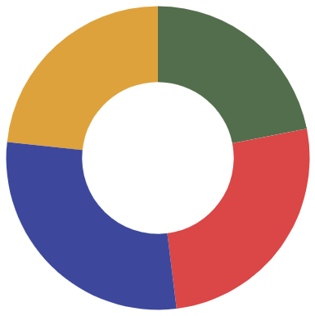
Budget
Venus
Venus is terribly hot
$83
$78
Mercury
Mercury is the smallest
Mars
Mars is a cold place
$102
$93
Jupiter
Follow the link in the graph to modify its data and then paste the new one here. For more info, click here
Jupiter is a gas giant

Slide 62
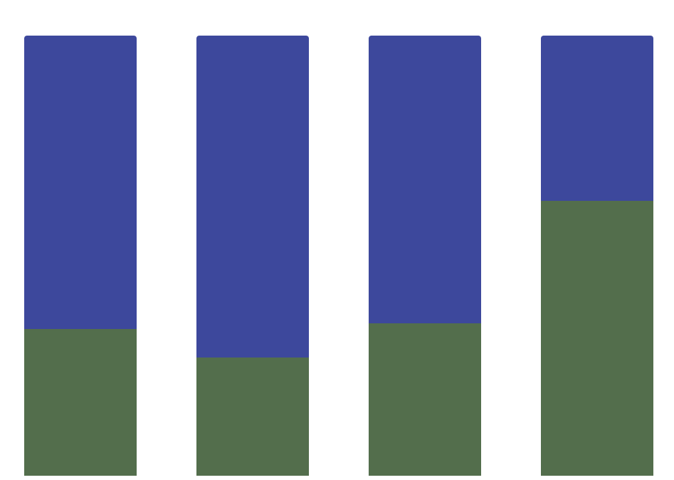
Budget
Mercury
Mercury is the closest planet to the Sun and the smallest one of them all
A
B
C
D
Jupiter
Venus has a very beautiful name and is the second planet from the Sun
Follow the link in the graph to modify its data and then paste the new one here. For more info, click here

Slide 63
Feasibility Review
Mercury
Saturn
Mercury is the smallest planet
Saturn is a gas giant and has rings
Neptune
Jupiter
Neptune is very far away from Earth
Jupiter is the biggest planet of them all
Venus
Mars
Venus has a very beautiful name
Despite being red, Mars is cold

Slide 64
Feasibility Review
Neptune
Mercury
Neptune is very far away from Earth
Mercury is the
Smallest planet
Jupiter
It’s a gas giant and the biggest planet

Slide 65
Evaluation Scores
Position | Phase 1 | Phase 2 | Phase 3 | Phase 4 | Phase 5
Mercury is the smallest planet
Despite being red, Mars is a cold place
It's a gas giant and the biggest planet
Venus is the second planet to the Sun
It’s the farthest planet from the Sun

Slide 66
Evaluation Scores
Venus
70%
Venus is the second planet to the Sun
Mercury
50%
Mercury is the closest planet to the Sun
Mars
25%
Despite being red, Mars is a cold place

Slide 67
Launch Monitoring Dashboard
Project
Priority
Status
It’s the only one that harbors life
High
In Progress
It’s a gas giant and has several rings
Low
Completed
It’s a gas giant and the biggest planet
Normal
Not Started
It’s the fourth-largest planet of them all
High
Done

Slide 68
Launch Monitoring Dashboard
Structure
Systems
Mars is the fourth planet from the Sun
It is the fourth-largest planet by diameter
25%
80%
Low
In progress
High
Completed

Slide 69

Desktop Software
You can replace the image on the screen with your own work. Just delete this one, add yours and center it properly

Slide 70
Tablet App
You can replace the image on the screen with your own work. Just delete this one, add yours and center it properly

Slide 71
Mobile Web
You can replace the image on the screen with your own work. Just delete this one, add yours and center it properly

Slide 72
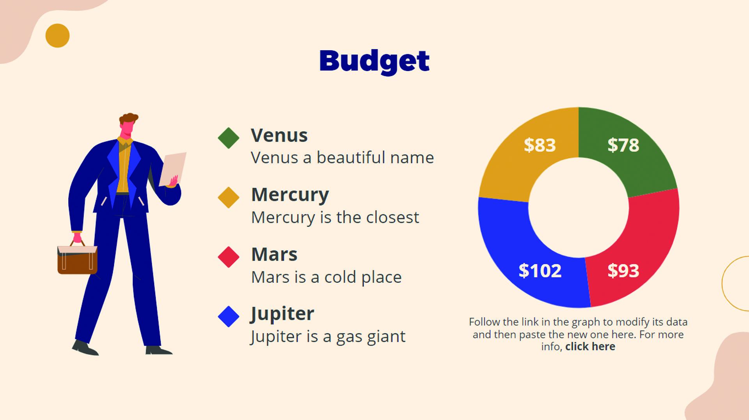
Laptop
You can replace the image on the screen with your own work. Just delete this one, add yours and center it properly

Slide 73


Our Team
Miguel James
Sarah Galvan
You can talk about this person here
You can talk about this person here

Slide 74
Thanks!
Do you have any questions? youremail@freepik.com
+91 620 421 838 yourcompany.com
Please keep this slide for attribution

Slide 75
Setup and Settings Icon Pack

Slide 76
Alternative Resources

Slide 77
Alternative Resources

Slide 78
Alternative Resources

Slide 79
Alternative Infographic Elements

Slide 80
Alternative Resources
Photos
Multiracial employees shaking hands in office
Colleagues in contemporary office coworking
African american man sitting copy space
Colleagues in contemporary office coworking
Smiling young businessman and businesswoman giving high five in front of corporate building
Man looking at watch and talking on phone on his way to work

Slide 81
Resources
Vectors
Business infographic design
Business infographic template with puzzle
Businesswomen and businessmen with devices
Businesswomen and businessmen working
Copyright landing page template
Round infographic of human brain
People with technology devices
Photos
Event manager showing laptop to happy woman
Group of three modern architects

Slide 82
Use our editable graphic resources...
You can easily resize these resources without losing quality. To change the color, just ungroup the resource and click on the object you want to change. Then, click on the paint bucket and select the color you want. Group the resource again when you’re done. You can also look for more infographics on Slidesgo.

